Slide 1

7th Grade Math
Unit 6, Lesson 8 Solving Real-World Problems Involving Proportions Volume 1, pg. 273

Slide 2


Benchmark
MA.7.AR.3.2
Apply previous understanding of ratios to solve real-world problems involving proportions.
volume 1, pg. 273

Slide 3
Integrated Mathematical Thinking and Reasoning Standards
MA.K12.MTR.5.1 Use patterns and structure to help understand and connect mathematical concepts.
MA.K12.MTR.7.1 Apply mathematics to real-world contexts.
volume 1, pg. 273

Slide 4

Learning Target
I can solve problems using proportions.
volume 1, pg. 273

Slide 5

Warm-Up
volume 1, pg. 274

Slide 6
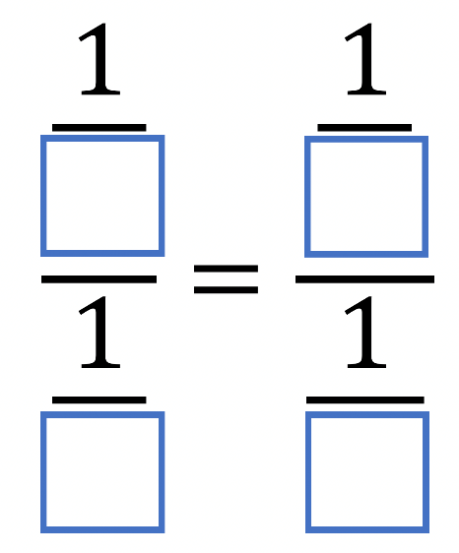
6.8.1 Warm-Up: Proportions with Fractions
Place a digit in each blue box to make the equality statement true. Use only digits 1 to 9, at most one time each.
volume 1, pg. 274

Slide 7

Exploration
volume 1, pg. 274

Slide 8

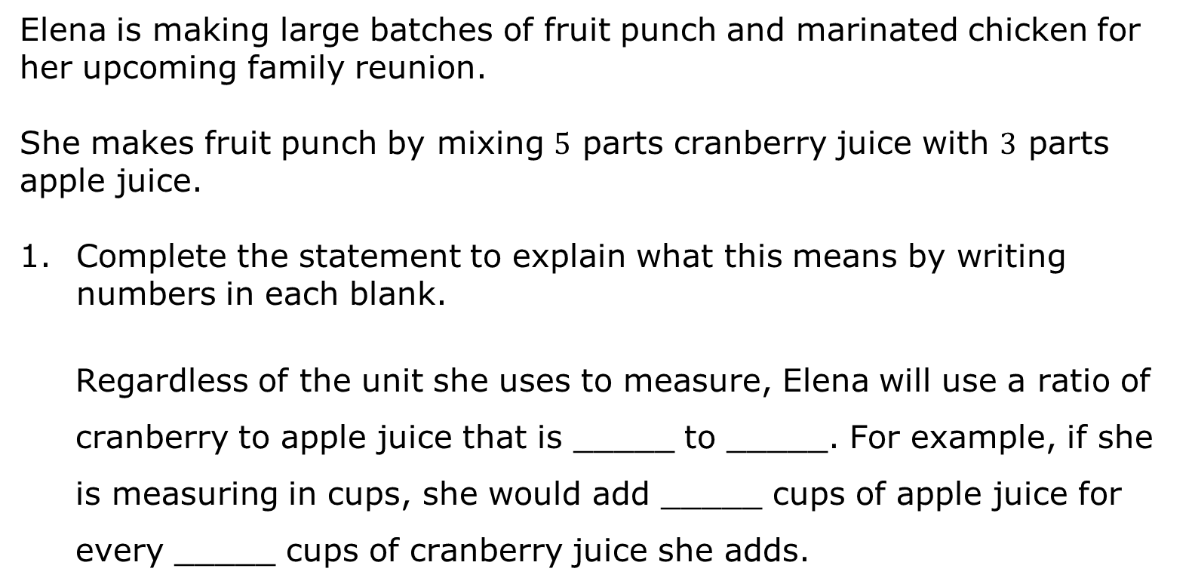
6.8.2 Exploration: Which Information Should I Use?
Elena is making large batches of fruit punch and marinated chicken for her upcoming family reunion.
She makes fruit punch by mixing $5$ parts cranberry juice with $3$ parts apple juice.
Complete the statement to explain what this means by writing numbers in each blank.
Regardless of the unit she uses to measure, Elena will use a ratio of cranberry to apple juice that is _____ to _____. For example, if she is measuring in cups, she would add _____ cups of apple juice for every _____ cups of cranberry juice she adds.
volume 1, pg. 274

Slide 9
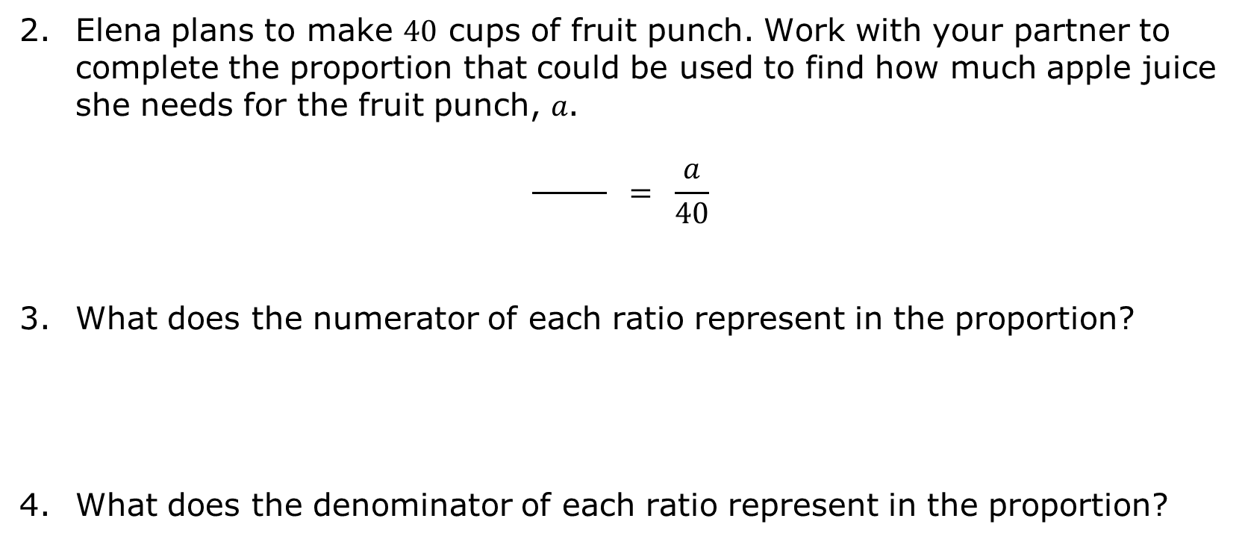
Elena plans to make $40$ cups of fruit punch. Work with your partner to complete the proportion that could be used to find how much apple juice she needs for the fruit punch, 𝑎.
$$\frac{ }{ } = \frac{a}{40}$$
What does the numerator of each ratio represent in the proportion?
What does the denominator of each ratio represent in the proportion?
volume 1, pg. 274

Slide 10
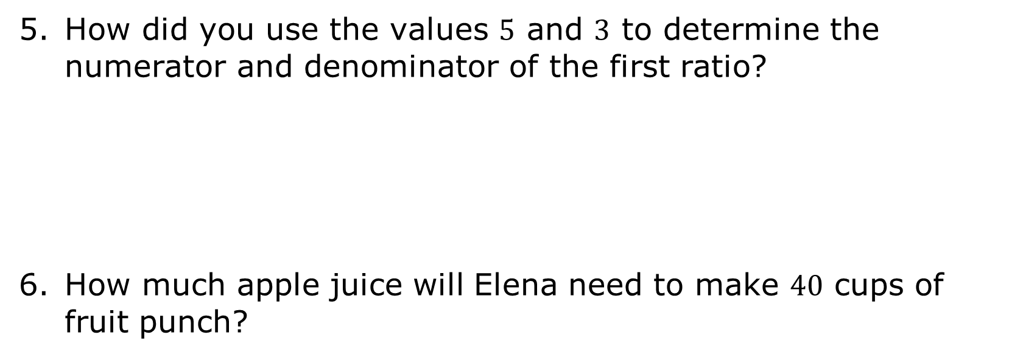
How did you use the values $5$ and $3$ to determine the numerator and denominator of the first ratio?
How much apple juice will Elena need to make $40$ cups of fruit punch?
volume 1, pg. 275

Slide 11
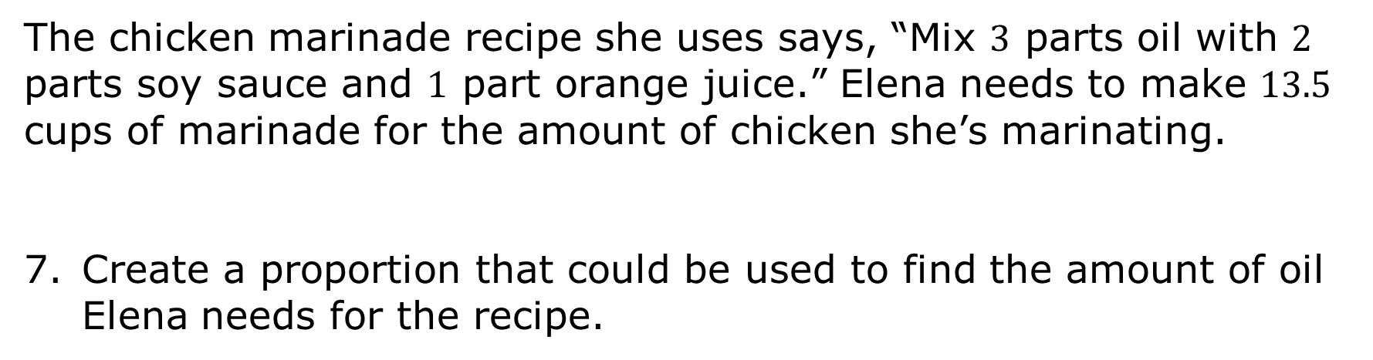
The chicken marinade recipe she uses says, “Mix $3$ parts oil with $2$ parts soy sauce and $1$ part orange juice.” Elena needs to make $13.5$ cups of marinade for the amount of chicken she’s marinating.
Create a proportion that could be used to find the amount of oil Elena needs for the recipe.
volume 1, pg. 275

Slide 12
Elena is scaling the recipe up to make a larger batch. By what scale factor is Elena enlarging the recipe? Explain or show how you know.
How could this scale factor be used to determine how many cups of each ingredient she needs to make the marinade?
volume 1, pg. 275

Slide 13
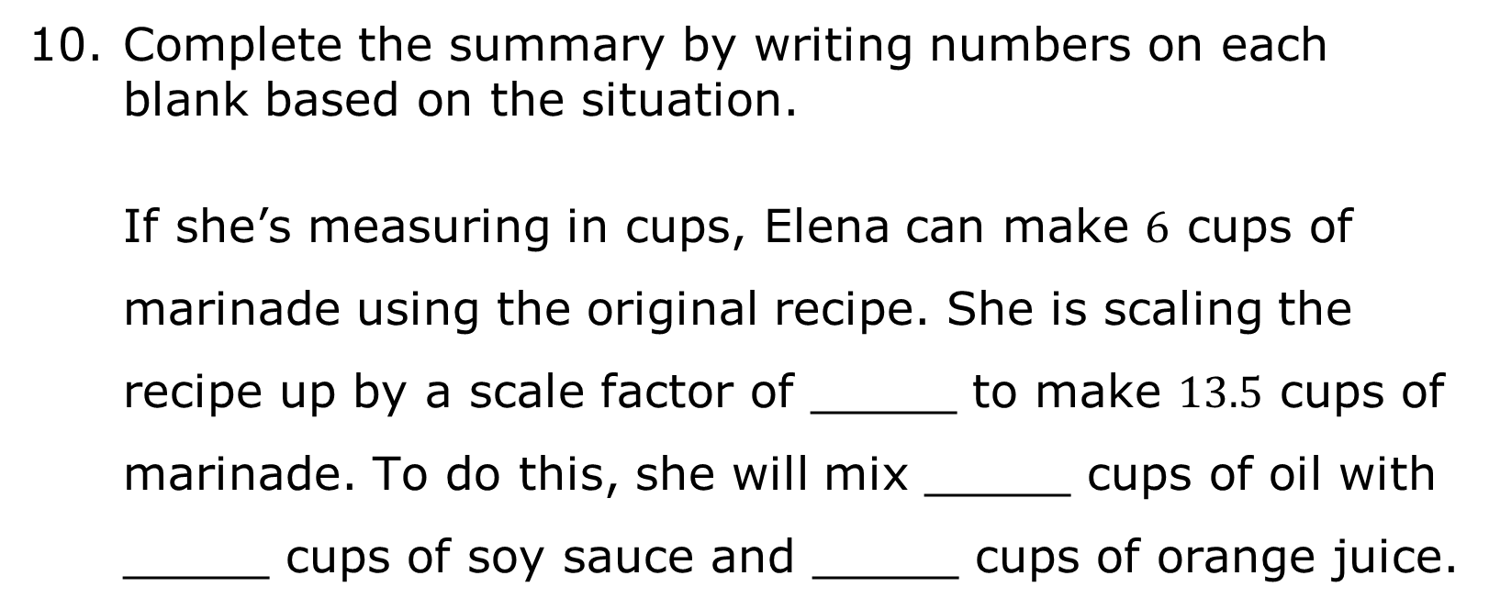
Complete the summary by writing numbers on each blank based on the situation.
If she’s measuring in cups, Elena can make $6$ cups of marinade using the original recipe. She is scaling the recipe up by a scale factor of _____ to make $13.5$ cups of marinade. To do this, she will mix _____ cups of oil with _____ cups of soy sauce and _____ cups of orange juice.
volume 1, pg. 275

Slide 14

Bring It Together
volume 1, pg. 275

Slide 15

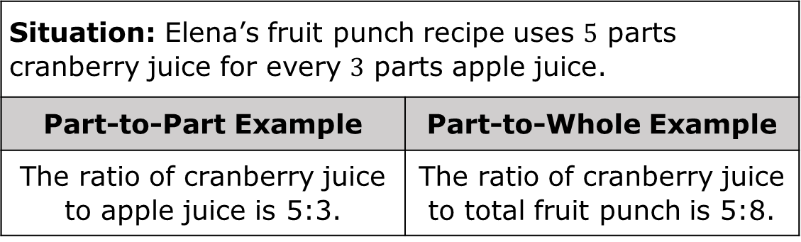
6.8.3 Bring It Together: Proportions
Recall that ratios can be used to describe part-to-part relationships or part-to-whole relationships.
Situation: Elena’s fruit punch recipe uses $5$ parts cranberry juice for every $3$ parts apple juice.
Part-to-Part Example | Part-to-Whole Example
The ratio of cranberry juice to apple juice is 5:3. | The ratio of cranberry juice to total fruit punch is 5:8.
When setting up proportions to solve problems, it’s important to first determine which quantities need to be compared to find the missing value.
volume 1, pg. 275

Slide 16
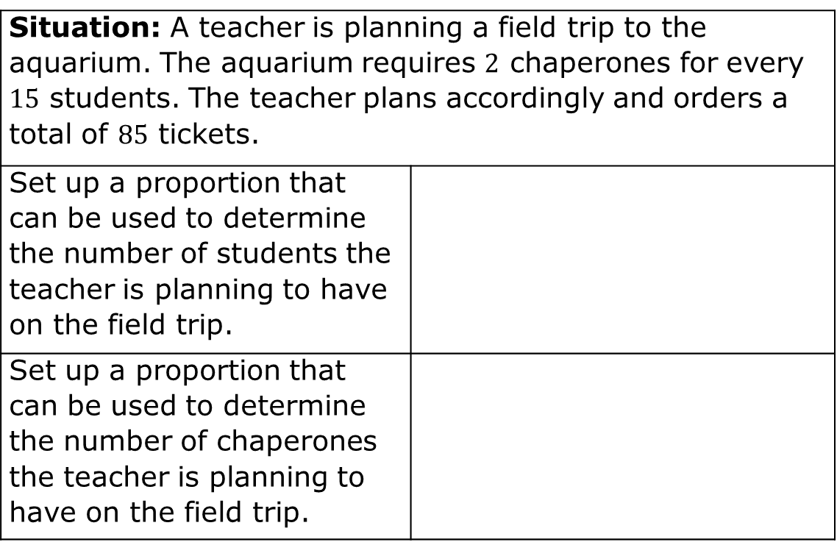
Complete the table.
Situation: A teacher is planning a field trip to the aquarium. The aquarium requires $2$ chaperones for every $15$ students. The teacher plans accordingly and orders a total of $85$ tickets.
Set up a proportion that can be used to determine the number of students the teacher is planning to have on the field trip.
Set up a proportion that can be used to determine the number of chaperones the teacher is planning to have on the field trip.
volume 1, pg. 276

Slide 17
Solve only one of the proportions above.
Explain how the solution to the proportion can be used to determine both the number of student tickets and the number of chaperone tickets the teacher ordered.
volume 1, pg. 276

Slide 18

Your Turn
volume 1, pg. 276

Slide 19

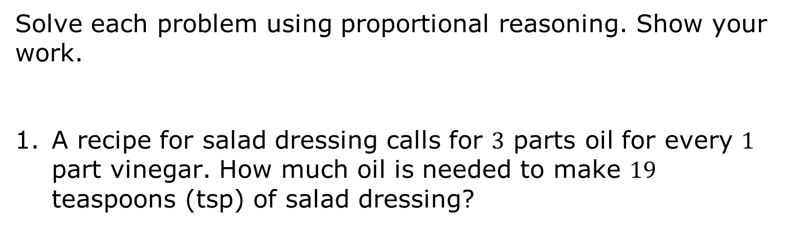
6.8.4 Your Turn!
Solve each problem using proportional reasoning. Show your work.
A recipe for salad dressing calls for $3$ parts oil for every $1$ part vinegar. How much oil is needed to make $19$ teaspoons (tsp) of salad dressing?
volume 1, pg. 276

Slide 20

A grocer can buy strawberries from a local farmer for $\$1.38$ per pound (lb). His last strawberry order cost $\$241.50$. How many pounds did the grocer order?
Andre and Han are moving boxes. Andre can move $4$ boxes every half hour. Han can move $5$ boxes every half hour. How long will it take Andre and Han to move all $72$ boxes?
volume 1, pg. 276

Slide 21

Wrap-Up
volume 1, pg. 277

Slide 22
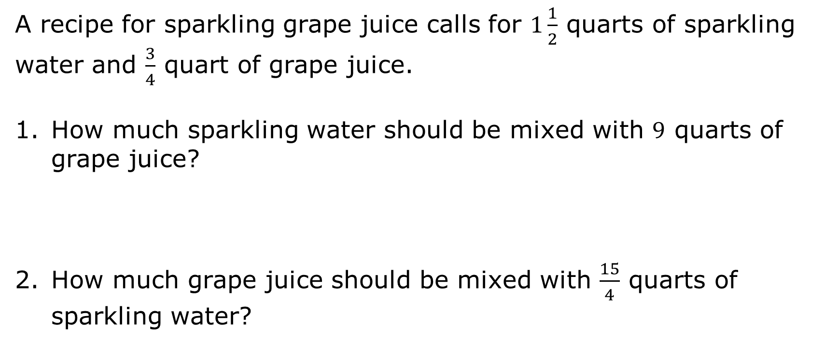
6.8.5 Wrap-Up: Ticket Out the Door
A recipe for sparkling grape juice calls for $1\frac{1}{2}$ quarts of sparkling water and $\frac{3}{4}$ quart of grape juice.
How much sparkling water should be mixed with $9$ quarts of grape juice?
How much grape juice should be mixed with $\frac{15}{4}$ quarts of sparkling water?
volume 1, pg. 277

